Slide 1
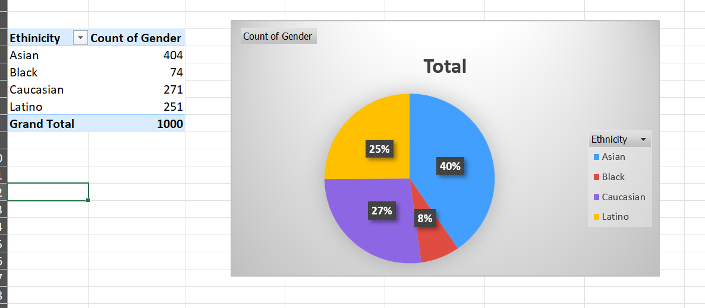
Question: can you provide a summary of the gender and ethnicity distribution within the company
I inserted a pivot table to handle the data set in an effective and elegant way.
After that I selected the Ethnicity data and the Gender data and did a count on them.
Later I plotted a pie chart to visualize the ethnicity of employees

Slide 2
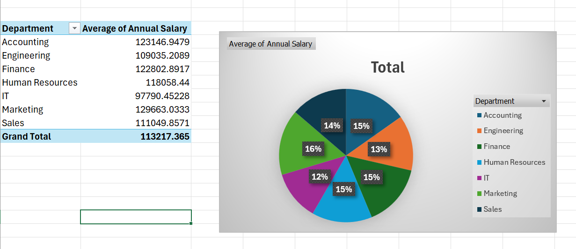
3. Is there any difference in average salaries between different departments
According to my observation after I deployed a pivot table and plotted the pie chart on the provided circumstances, I can observe that the average of annual salary is almost evenly distributed. There isn’t any significant difference.

Slide 3
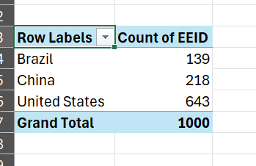
4. Which country has the highest number of employees.
After deploying pivot table and assessing everything, I got to know that united states has highest number of employees in the organisation.

Slide 4
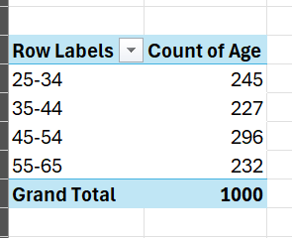
5. What is the most common age range among the employees
From my observation and based on the groupings I have done in the pivot table shown above, its clear that age range between 45 and 55 has most of the employees lying in it.

Slide 5
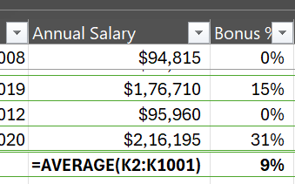
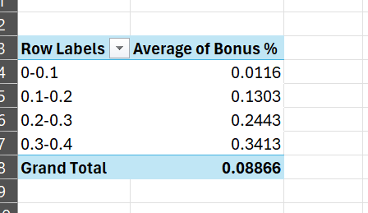
6. What is the average bonus percentage given to employees.
From the provided pictures we can observe the average bonus provided to employees

Slide 6
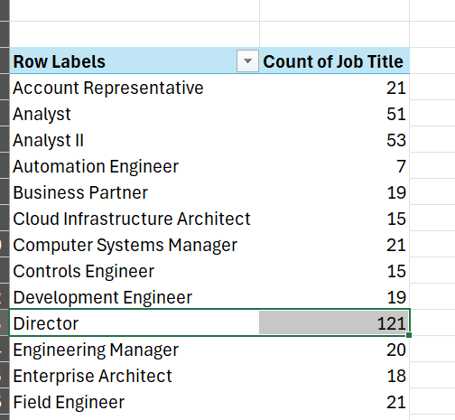
7.Which job title occurs most frequently.
Here we can observe that director file has occurred most of the times in the dataset.
I did that by calculating max first.

Slide 7
8. Primary reason for employee exit.
According to my observation only those employees are exititng who have age more that 45.

